Slide 1
Recommendation System using PySpark

Slide 2
Recommendation system
Content-based filtering
User past history
Collaborative filtering
User-user comparison
Movie-movie comparison
Latent factor methods

Slide 3
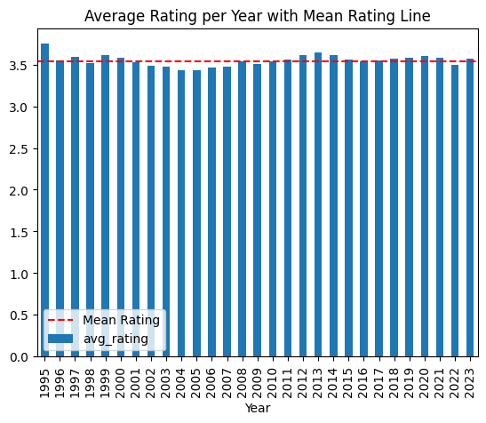
Data Split – Time based or Random?
Average rating per year
Mean: 3.55
Median: 3.548
Standard deviation: 0.067
Min rating: 3.43
Max rating: 3.75
Independent of time
Random split is fine

Slide 4
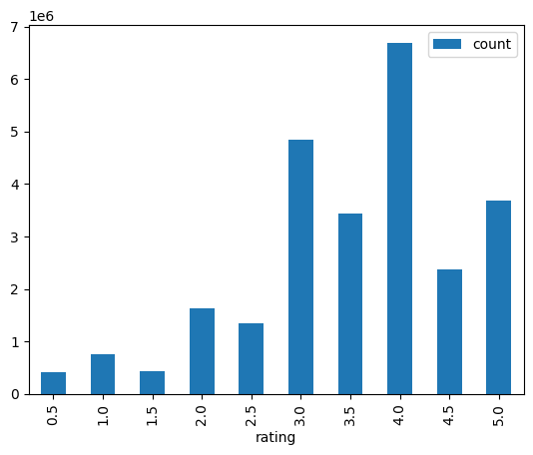
Training data Statistics
Train split: 80%
Number of users: 200948
Number of movies: 80185
Ratings are skewed

Slide 5

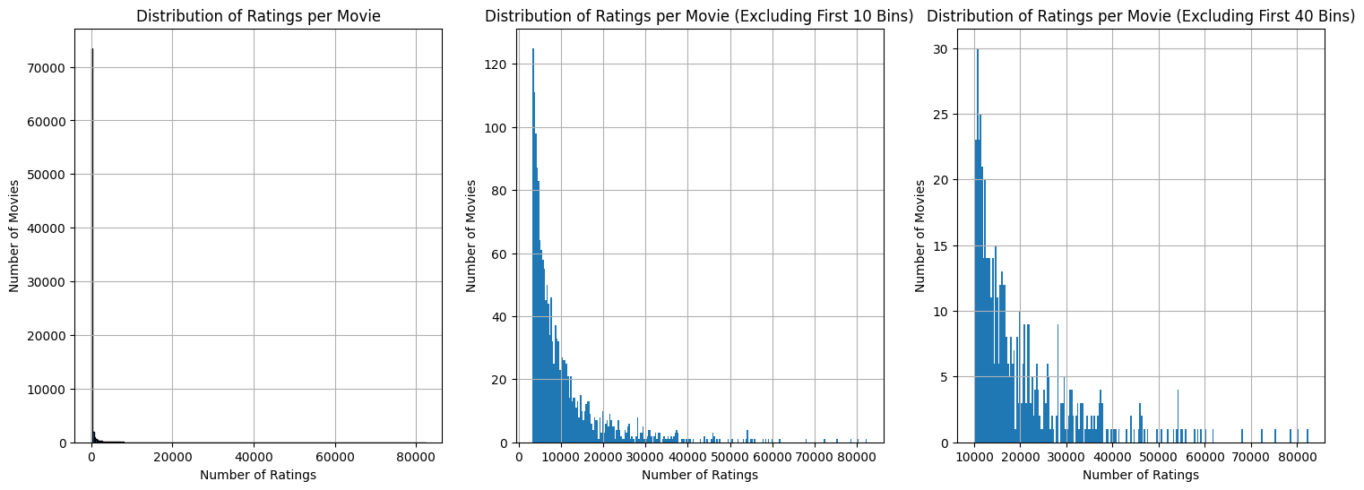
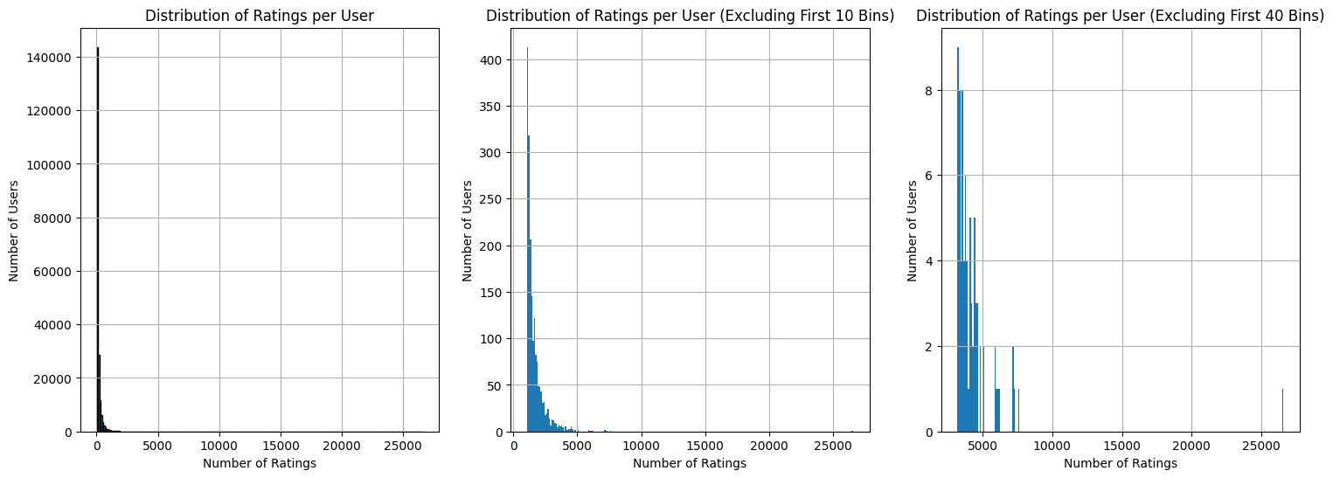
Users and Movies Distribution
Long Tail
Few users rated many movies
Few movies are rated by many users

Slide 6
Why not content-based filtering
< 0.15% matrix sparsity => content-based filtering

Slide 7
KNN
200k users and 84k movies
Time complexity for all users:
O(N^2 x M) = O(3.36 x 10^15) = 38.6 days
O(M^2 x N) = O(1.41 x 10^11) = 2.38 min
O(M^2) memory
Impossible for all users in single run
Dimensional reduction:
Not possible
Unbearable for even 84k movies

Slide 8
KNN Dimensional Reduction
K-D trees
Low dimensional and real-valued
O(M log2N), when M << N
Can miss neighbours
Inverted lists
High dimensional, sparse data
O(N’M’), where N’ << N, M’ << M
Exact
Locality-sensitive hashing
High-d, real-valued or discrete
O(N’M), N’ << N
Bits in fingerprint
Can miss neighbours

Slide 9
ALS

